Slide 1


Generative AI
Retrieval Augmented Generation (RAG)

Slide 2
outline
RAG

Slide 3
Retrieval Augmented Generation (RAG)

Slide 4
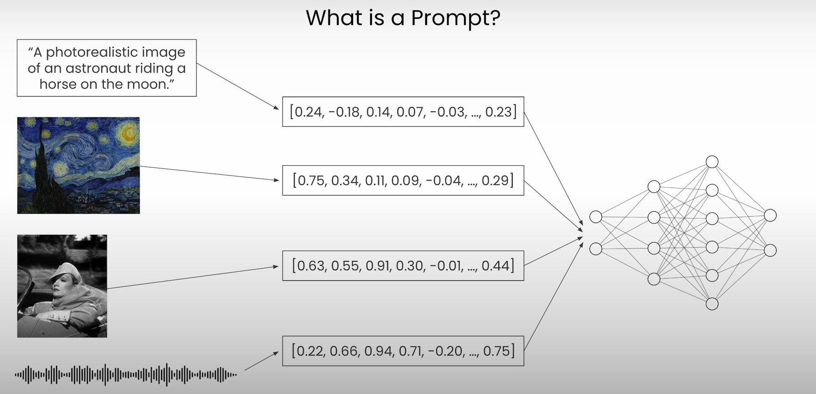
What is a prompt? - recap

Slide 5
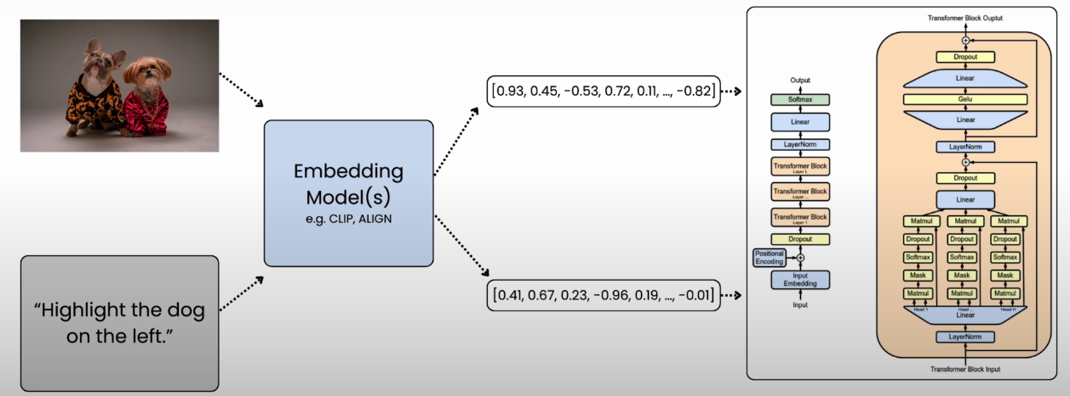
Embeddings - recap

Slide 6

Retrieval Augmented Generation (RAG) example
Retrieval augmented generation (RAG)
• Give LLM access to external data sources

Slide 7
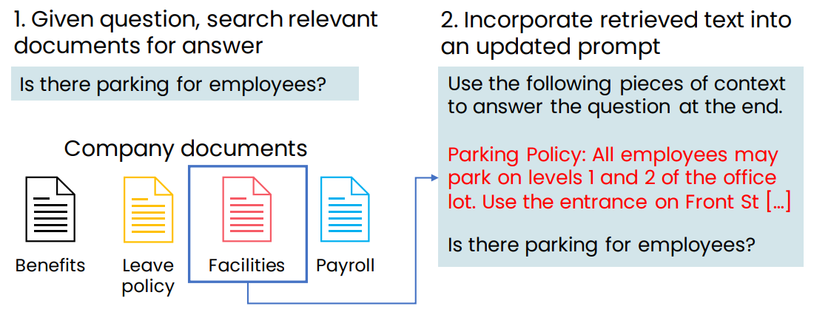
Retrieval Augmented Generation (RAG) example

Slide 8
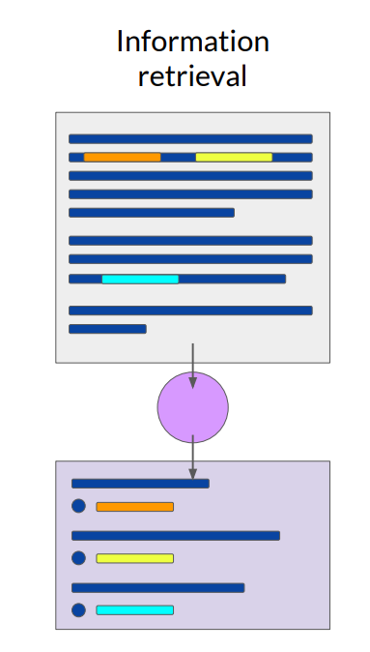
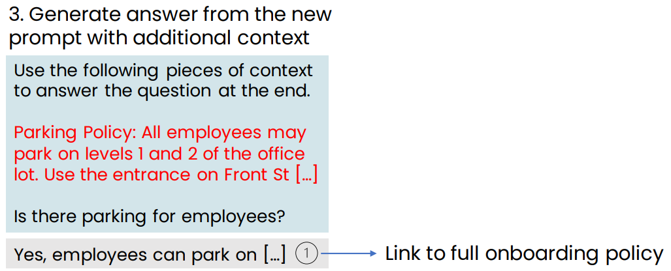
Retrieval Augmented Generation (RAG) example

Slide 9
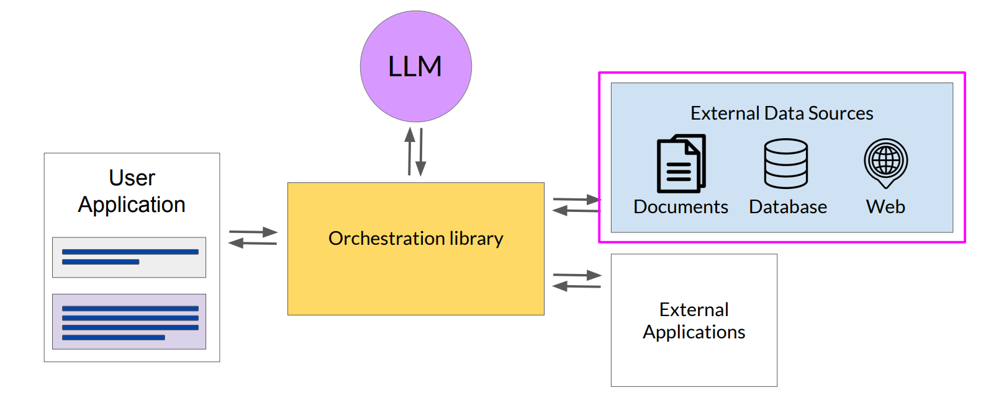
LLM-powered applications Retrieval Augmented Generation RAG

Slide 10
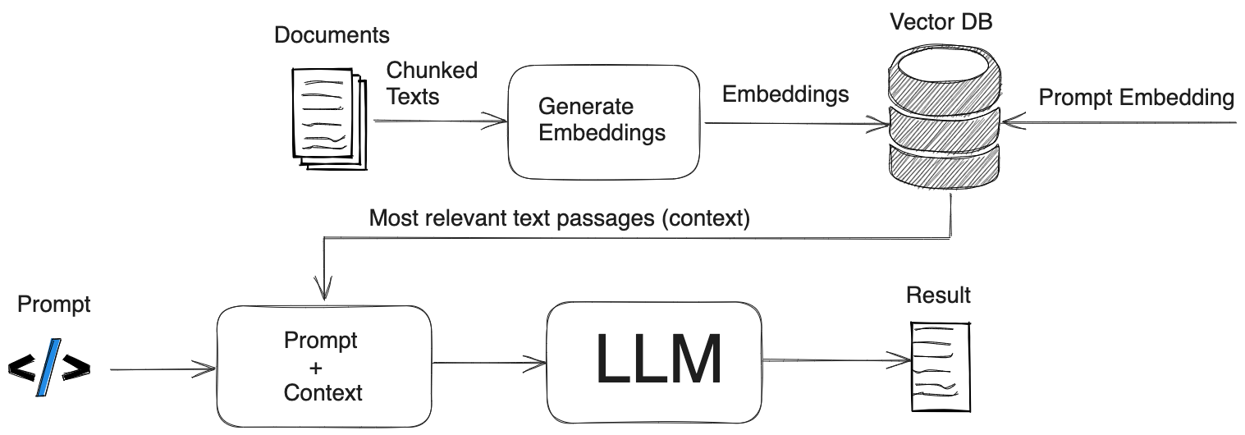
RAG

Slide 11
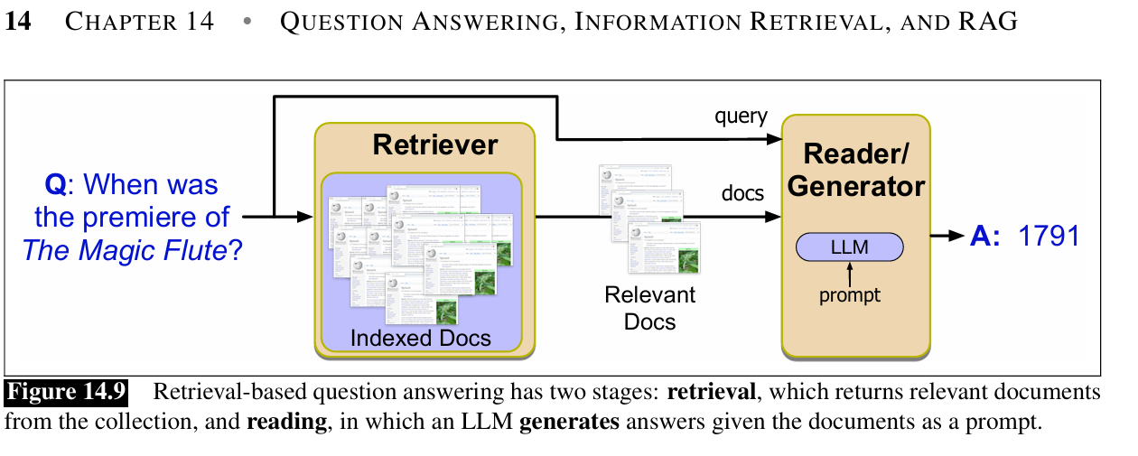
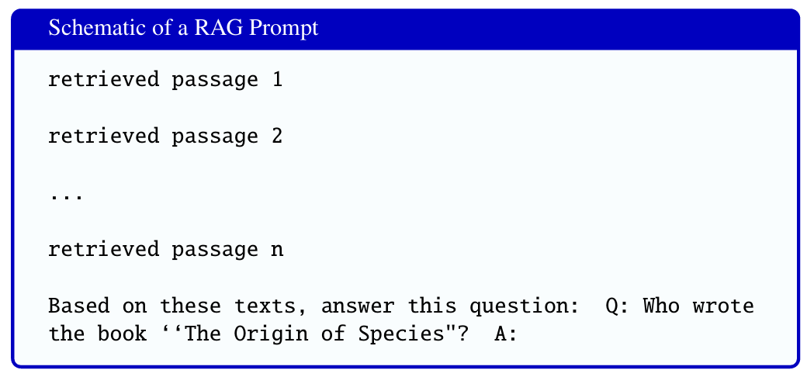

Slide 12
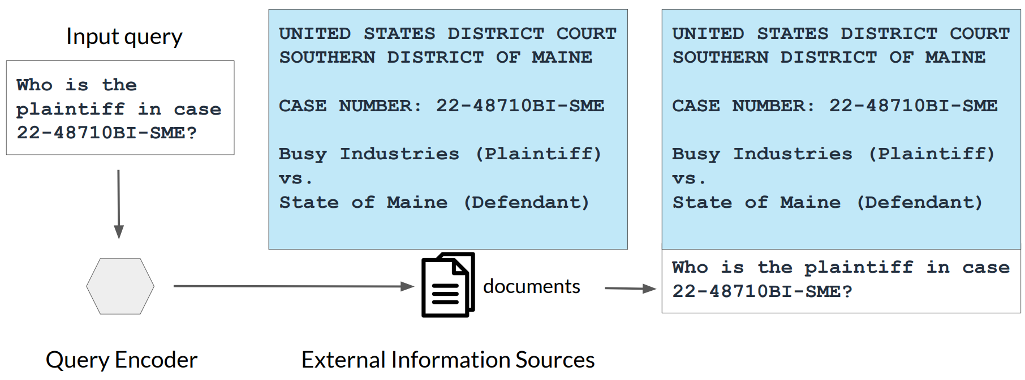
Example: Searching legal documents

Slide 13
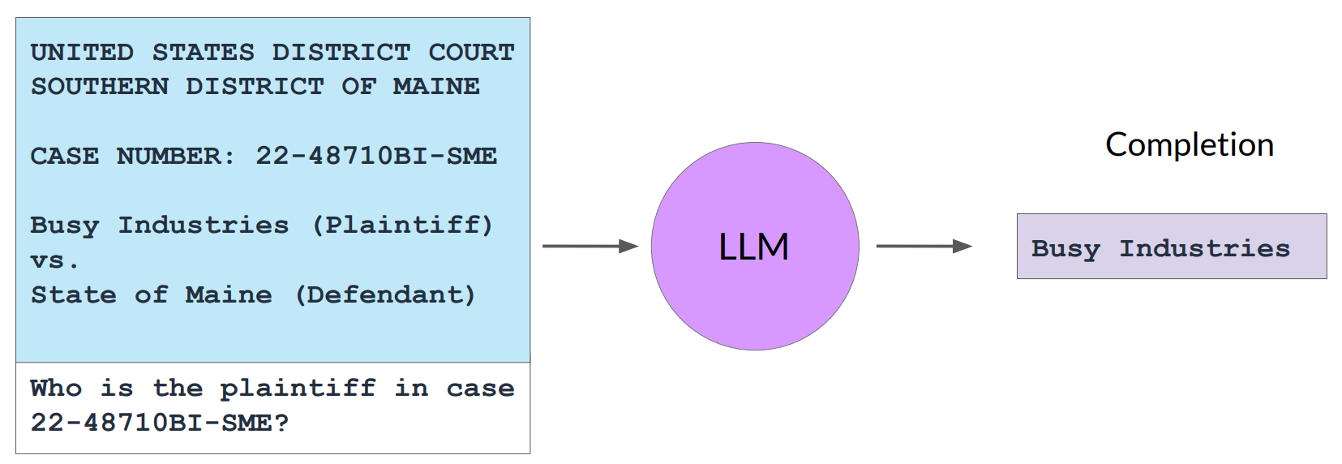
Example: Searching legal documents

Slide 14
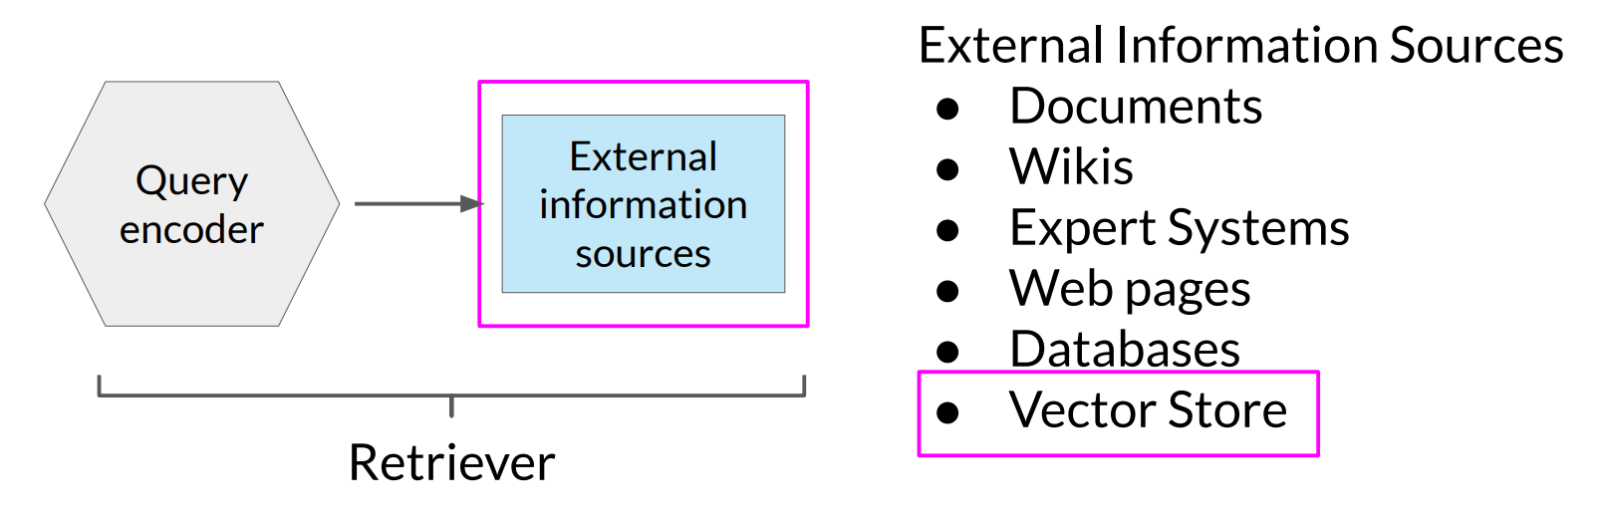
RAG integrates with many types of data sources

Slide 15

Examples of RAG applications

Slide 16
RAG applications
https://pandachat.ai
https://www.chatpdf.com
https://askyourpdf.com
https://pdf.ai
https://docAnalyzer.ai
https://lightpdf.com

Slide 17

Examples of RAG applications
Answer questions based on a website’s articles
Coursera Coach

Slide 18

Examples of RAG applications: Langchain Docs

Slide 19
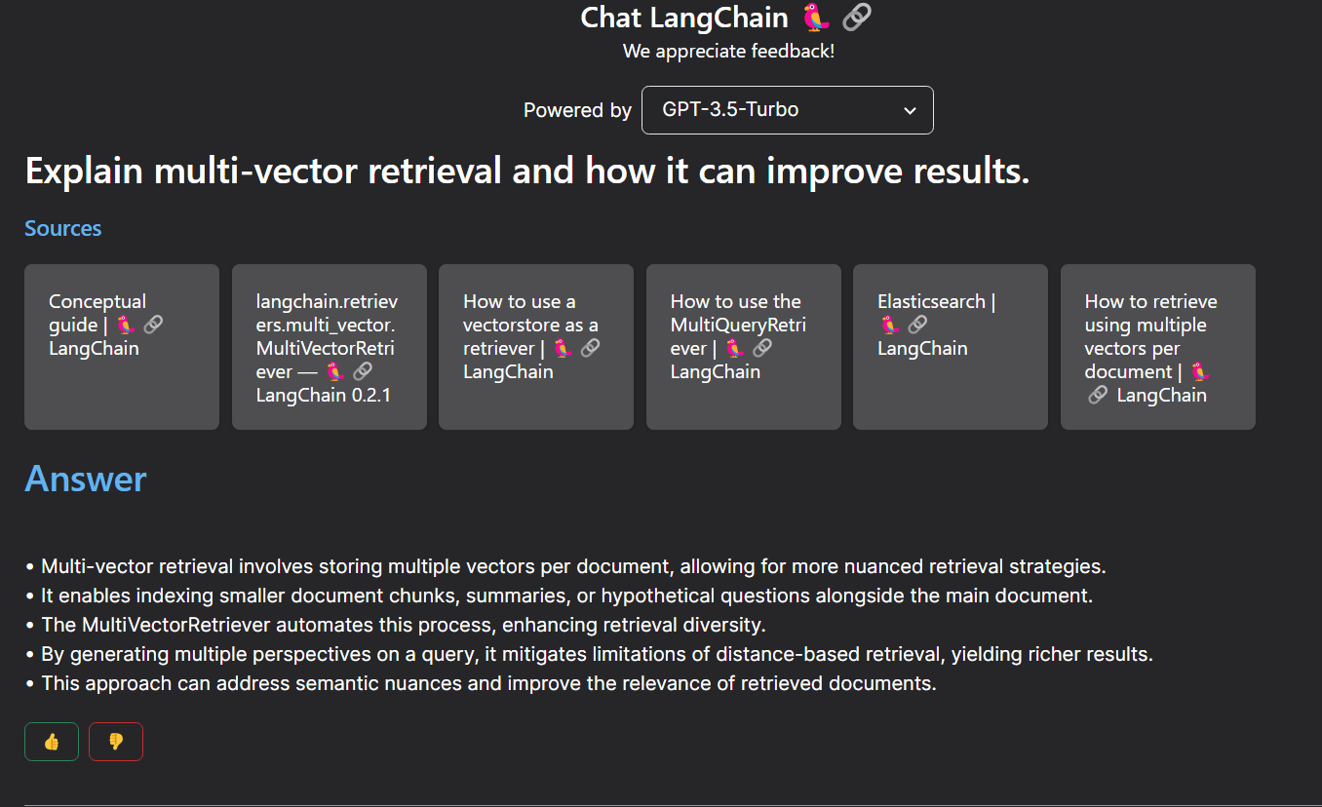
Examples of RAG applications: Langchain Docs

Slide 20
Tools

Slide 21
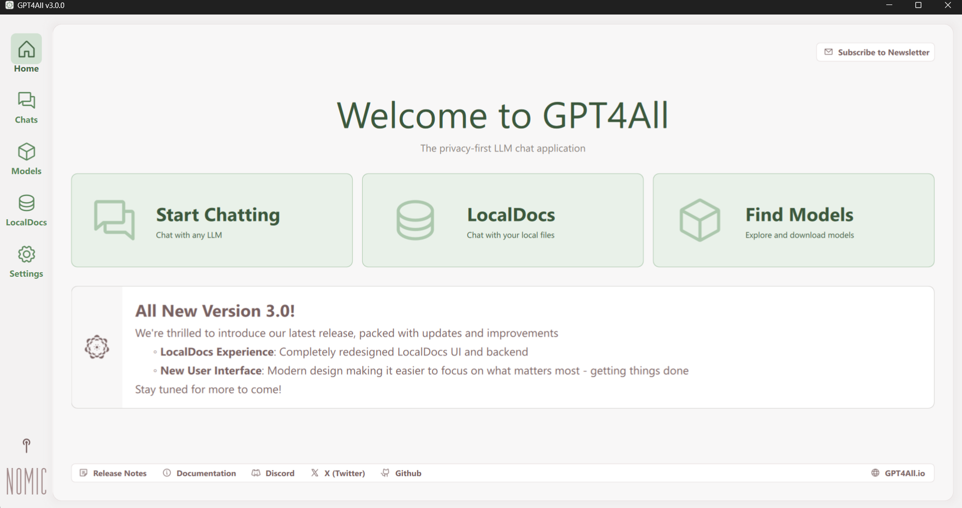
GPT4all RAG

Slide 22
LM Studio

Slide 23

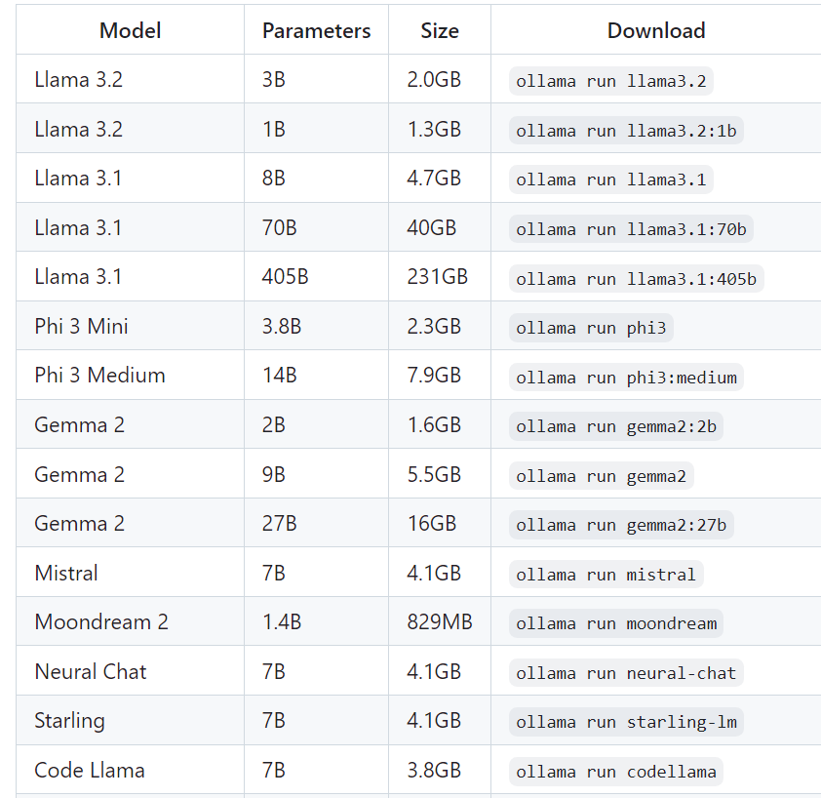

Ollama

Slide 24


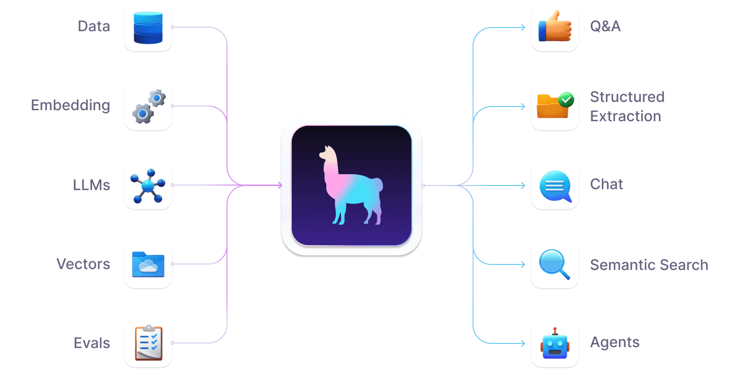
Llama Index

Slide 25
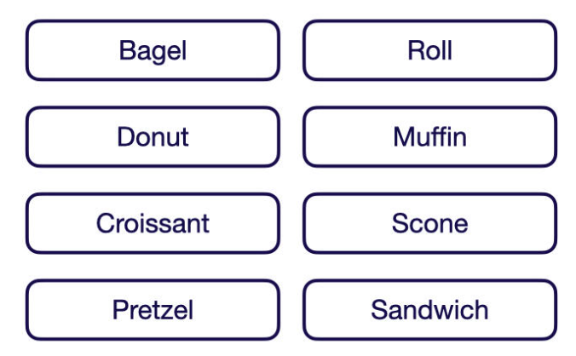
Evaluation Metrics for Search and RAG
To explain how each of the following metrics is calculated, this article uses a minimal example dataset of eight pastries

Slide 26

Metrics to Evaluate Information Retrieval Systems
Precision
The precision@K metric measures how many of the retrieved items are relevant.
This metric is not rank-aware and thus only considers the number of relevant results but not their order.
You can calculate precision@K by dividing the number of relevant items within the top K results by K.

Slide 27
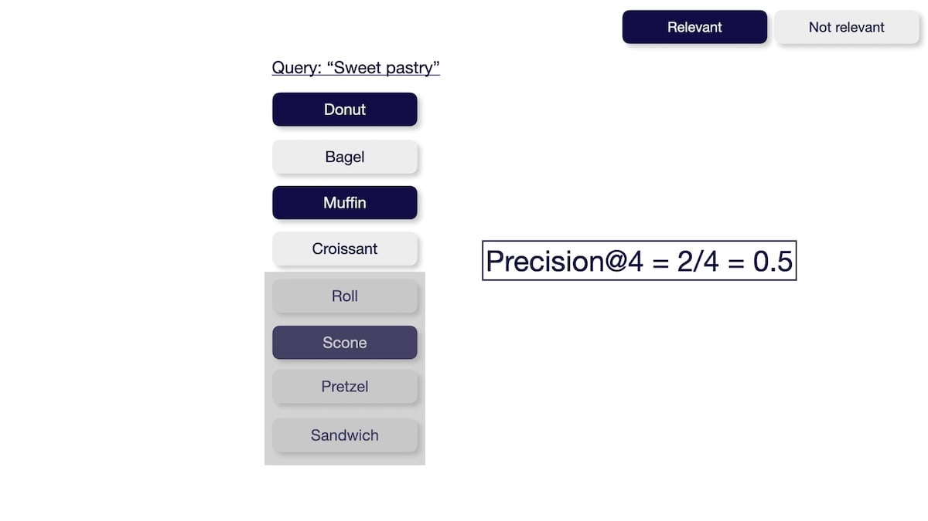

Slide 28

Recall
The recall@K metric measures how many relevant items were successfully retrieved from the entire dataset. This metric is not rank-aware and thus only considers the number of relevant results but not their order. You can calculate the recall@K by dividing the number of relevant items within the top K results by the total number of relevant items in the entire dataset.

Slide 29
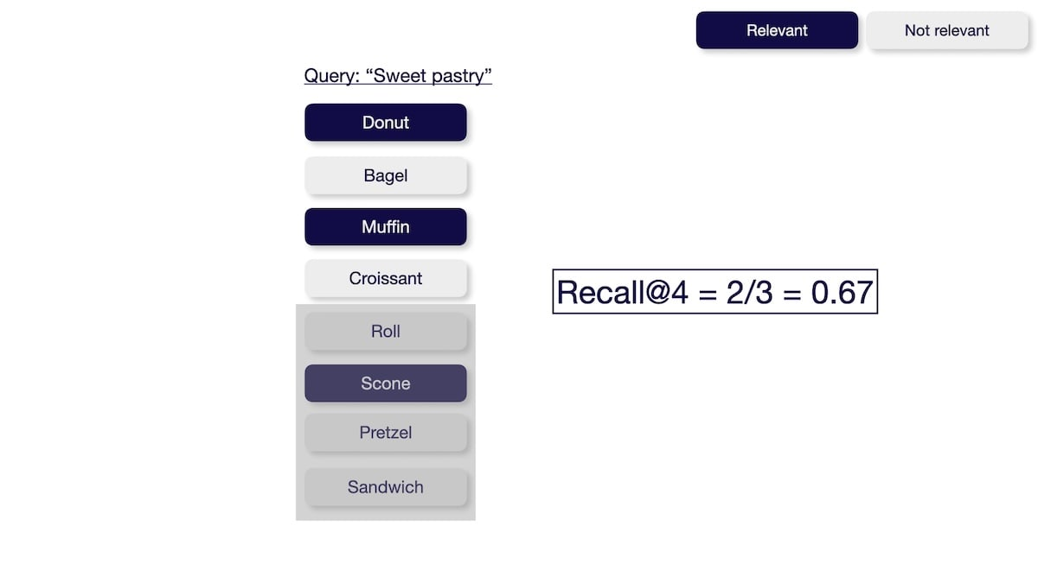

Slide 30


Mean Average Precision (MAP)
The Mean Average Precision@K (MAP@K) metric measures the system's ability to return relevant items in the top K results while placing more relevant items at the top.

Slide 31
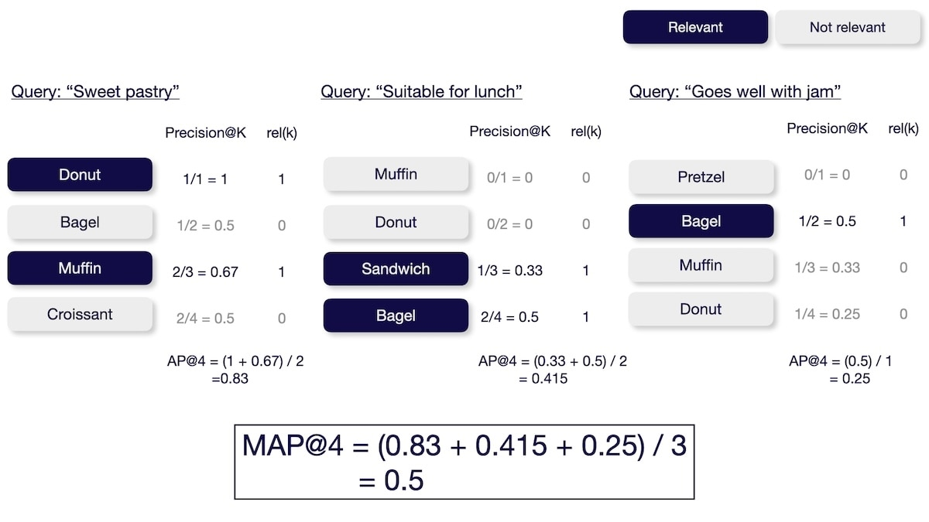

Slide 32
Normalized Discounted Cumulative Gain (NDCG)
The Normalized Discounted Cumulative Gain@K (NDCG@K) metric measures the system's ability to sort items based on relevance.
Requires not only if a document is relevant but also how relevant it is (e.g., relevant vs. somewhat relevant vs. not relevant).
You can calculate the NDCG@K by calculating the discounted cumulative gain (DCG) and then normalizing it over the ideal discounted cumulative gain (IDCG).

Slide 33
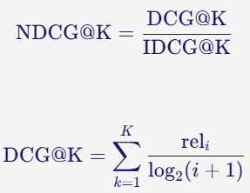
NDCG

Slide 34
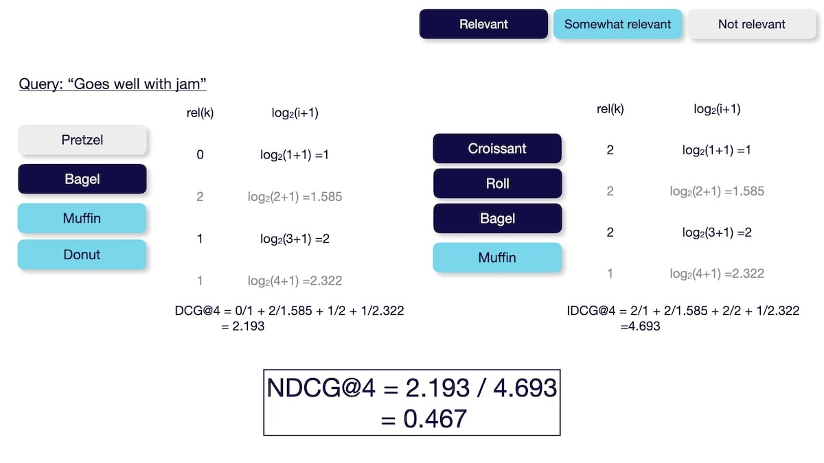

Slide 35


Q&A

